Slide 1
About Me
Name: Nirmal Parida
Total IT Exp: 15 Years
Public Cloud:
AWS
Azure
GCP
DevOps Tools:
CI/CD: Jenkins, GitLab
Deployment: Ansible
IaC: Terraform, CloudFormation
Docker, Kubernetes, ECS
Monitoring: Datadog

Slide 2
About The Course
AWS Solution Architect. (Also included major Developer services)
What contents to be provided
Sessions are ppt slide based.
More focused on hands on Learning
Exact document of slides will be provided
A complete document with detail steps will be provided for hands on labs.
Quiz Questions and Answers.
Expectations
Spend at least 8-10 hours per week
Practice most of the exercises

Slide 3
Introduction of Cloud Computing
What is Cloud Computing
History
Where we can use cloud
Features and benefits of cloud computing
Types of Cloud Deployment Model
Types of Cloud Computing Services
Virtualization in Cloud model
Types of Virtualization
What is a hypervisor
Hypervisor – Benefits
Cloud Service Providers
AWS Certifications and Jobs in market

Slide 4
What is Cloud Computing
Cloud computing is the on-demand delivery of IT resources over the Internet with pay-as-you-go pricing. Instead of buying, owning, and maintaining physical data centers and servers, you can access technology services, such as computing power, storage, and databases, on an as-needed basis from a cloud provider like Amazon Web Services (AWS).
In its simplest form, cloud computing provides an easy way to access servers, storage, databases, and a broad set of application services over the Internet.

Slide 5
History
In 1999, Salesforce.com started delivering of applications to users using a simple website.
In 2002, Amazon started Amazon Web Services, providing services like storage, computation
In 2009, Google Apps also started to provide cloud computing enterprise applications.
In 2009, Microsoft launched Windows Azure
In 2011, IBM announced the IBM SmartCloud framework to support Smarter Planet

Slide 6
Where we can use cloud?
File storage
Big Data Analytics
Data backups and archiving
Disaster recovery
Software testing and development
Social Networking
Infrastructure as a service (IaaS) and platform as a service (PaaS)

Slide 7
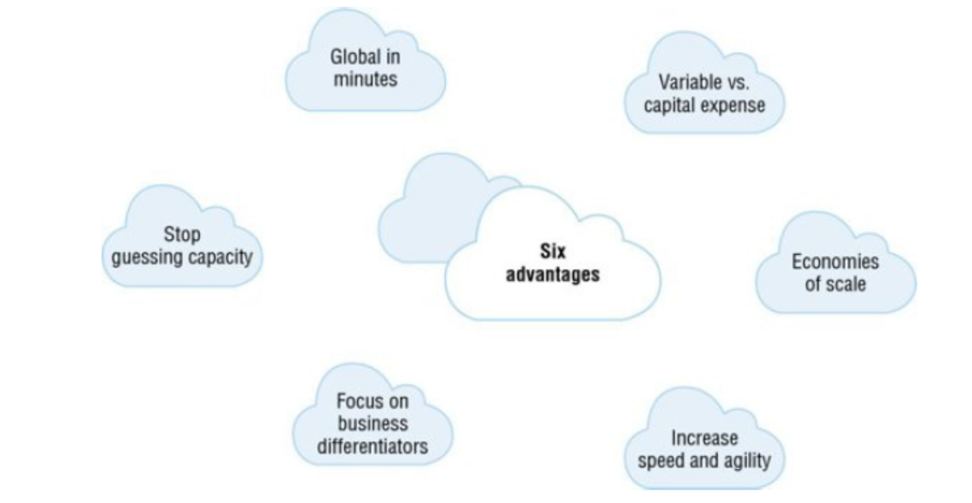
Features and benefits of cloud computing

Slide 8
Instead of having to invest heavily in data centers and servers before knowing how you’re going to use them, you can pay only when you consume computing resources and pay only for how much you consume
By using cloud computing, you can achieve a lower variable cost than you would get on your own
With cloud computing, organizations can stop guessing about capacity requirements for the infrastructure necessary to meet their business needs
In a cloud computing environment, new IT resources are one click away, which allows organizations to reduce the time it takes to make those resources available to developers from weeks to just minutes
Cloud computing allows organizations to focus on their business priorities, instead of on the heavy lifting of racking, stacking, and powering servers
Organizations can easily deploy their applications to multiple locations around the world with just a few clicks

Slide 9
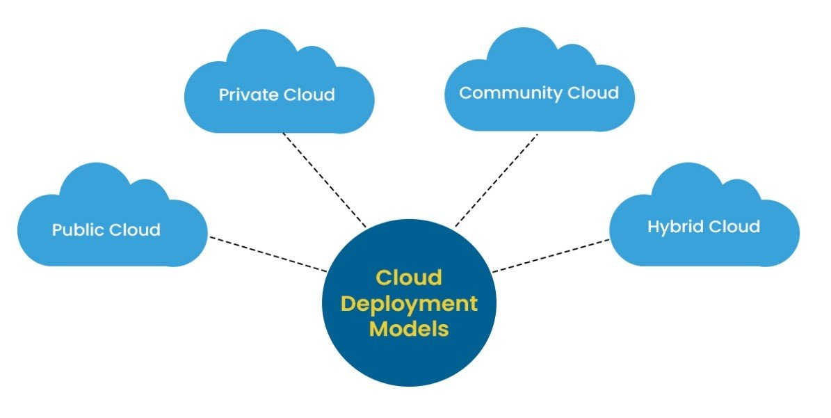
Types of Cloud Deployment Model

Slide 10
Public Cloud
The entire computing infra is located on the premises of the CSP
Most economical option for those individuals/organizations that do not wish to invest in IT infrastructure.
Private Cloud
Its own Cloud Environment/Datacenters.
The security and control level is highest while using a private network.
Hybrid Cloud
Combination Public Cloud and Private Cloud.
It allows the sharing of data and applications between Public and Private Cloud environments.
Organizations mainly use Hybrid Cloud when their On-Premise infrastructure needs more scalability
Community Cloud
Its shared by users of the same industry or by those who have common goals.
This Cloud infrastructure is built after understanding the computing needs of a community as there are many factors including compliances and security policies which need to be included in the community Cloud infrastructure.

Slide 11
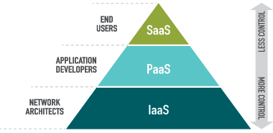
Types of Cloud Computing Services
Infrastructure as a Service (IaaS)
It provides a completely virtualized computing infrastructure that is provisioned and managed over the internet
An IaaS provider manages the physical infrastructure (servers, data storage space, etc) in a data center, but allows customers to fully customize those virtualized resources to suit their specific needs.
Ex: Microsoft Azure, Amazon Web Services (AWS), Cisco Metacloud, Google Compute Engine (GCE)

Slide 12
Platform as a Service (PaaS)
PaaS provides the framework needed to build, test, deploy, manage, and update software products.
It utilizes the same basic infrastructure as IaaS, but it also includes the operating systems, middleware, development tools, and database management systems needed to create software applications.
Most PaaS tools provide extensive pre-coded applications built into the platform, which can greatly reduce coding time and help companies get their products to market faster.
Examples of PaaS: AWS Elastic Beanstalk, Apache Stratos, Google App Engine, Microsoft Azure

Slide 13
Software as a Service (SaaS)
SaaS is a fully-developed software solution ready for purchase and use over the internet on a subscription basis.
The SaaS provider manages the infrastructure, operating systems, middleware, and data necessary to deliver the program, ensuring that the software is available whenever and wherever customers need it.
Many SaaS applications run directly through web browsers, eliminating the need for downloads or installations.
Examples of SaaS: Microsoft Office 365, Salesforce, Cisco WebEx, Google Apps.

Slide 14
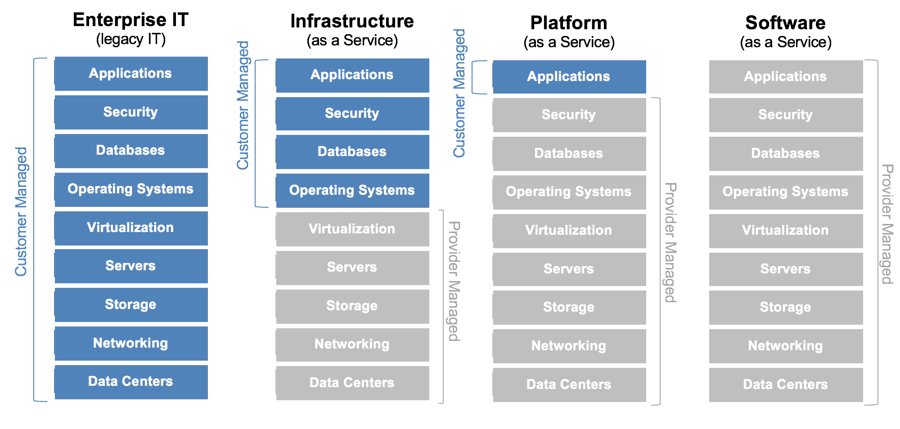

Slide 15
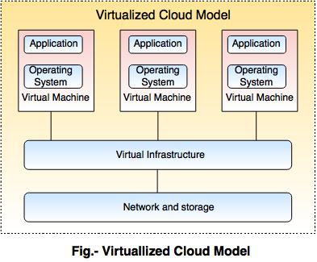
Virtualization in Cloud model
Virtualization allows to share a single physical instance of a resource or an application among multiple customers and organizations at one time.
It does this by assigning a logical name to a physical storage and providing a pointer to that physical resource on demand

Slide 16
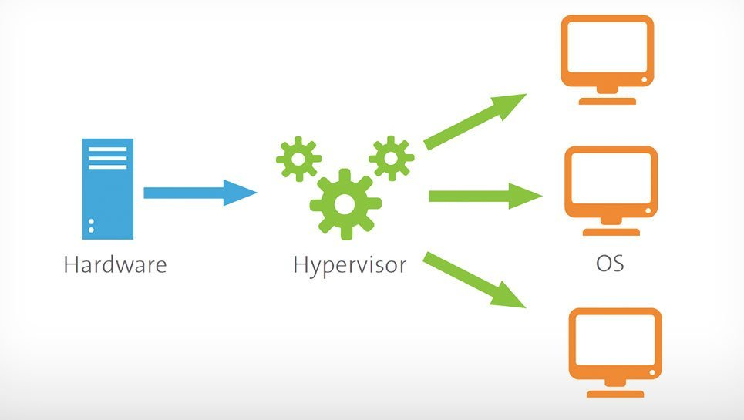
What is a hypervisor
A hypervisor, also known as a virtual machine monitor or VMM, is software that creates and runs virtual machines (VMs).
A hypervisor allows one host computer to support multiple guest VMs by virtually sharing its resources, such as memory and processing.

Slide 17
Hypervisor – Benefits
Speed: Hypervisors allow virtual machines to be created instantly.
Efficiency: Hypervisors that run several virtual machines on one physical machine’s resources also allow for more efficient utilization of one physical server
Flexibility: Bare-metal hypervisors allow operating systems and their associated applications to run on a variety of hardware types because the hypervisor separates the OS from the underlying hardware, so the software no longer relies on specific hardware devices or drivers.
Portability: Hypervisors allow multiple operating systems to reside on the same physical server (host machine).

Slide 18
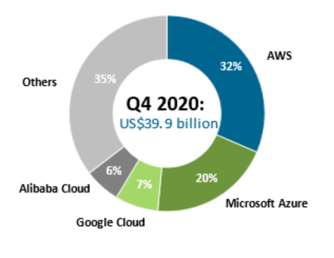
Cloud Service Providers
Amazon Web Services (AWS)
Microsoft Azure
Google Cloud
Alibaba Cloud
IBM Cloud
Oracle
Salesforce
SAP
Rackspace Cloud
VMWare

Slide 19
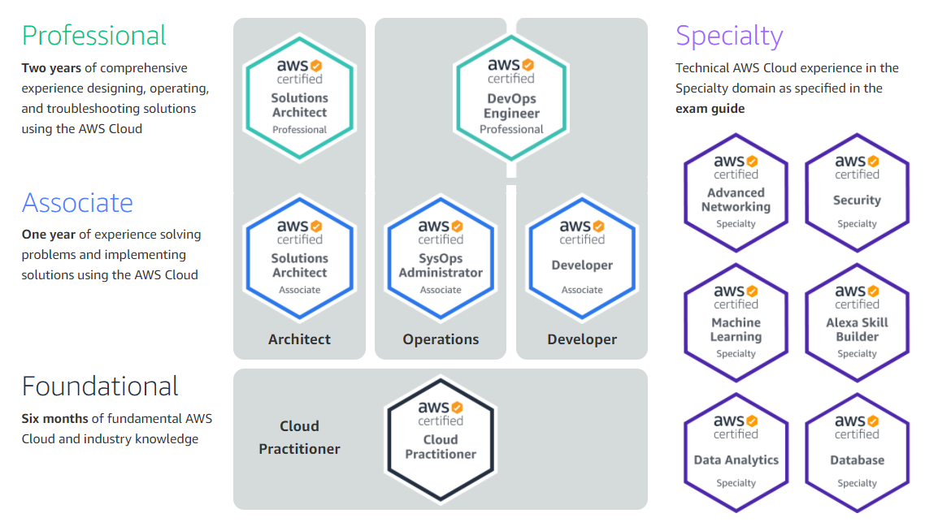
AWS Certifications

Slide 20
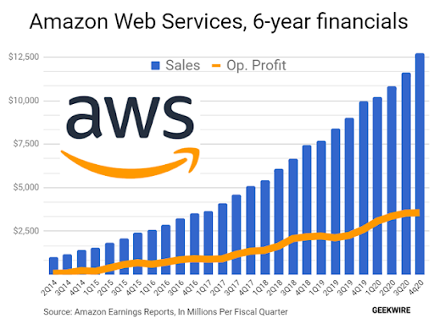
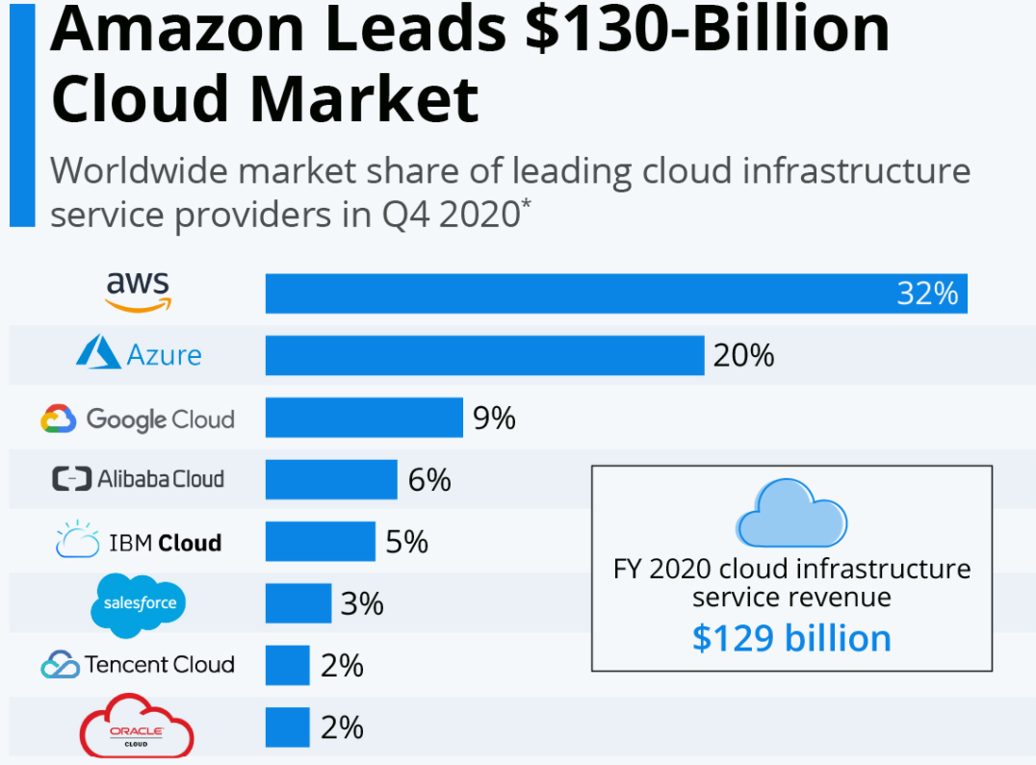
AWS Cloud Trends and Jobs

